Slide 1

Eric Montiel & Samuel Levis

Slide 2


Introduction
Volodymyr Agafonkin
Leaflet is an open-source JavaScript library created and released in 2011 intended to create interactive maps on the web.
It is widely used for building interactive and mobile-friendly mapping applications due to its flexibility, ease of use, and extensive plugin ecosystem. Leaflet is often used in conjunction with other web technologies such as HTML, CSS, and various JavaScript frameworks to create powerful mapping solutions for web applications.
Websites that use leaflet include: booking.com, pintrest.com and fiverr.com, weather.com

Slide 3
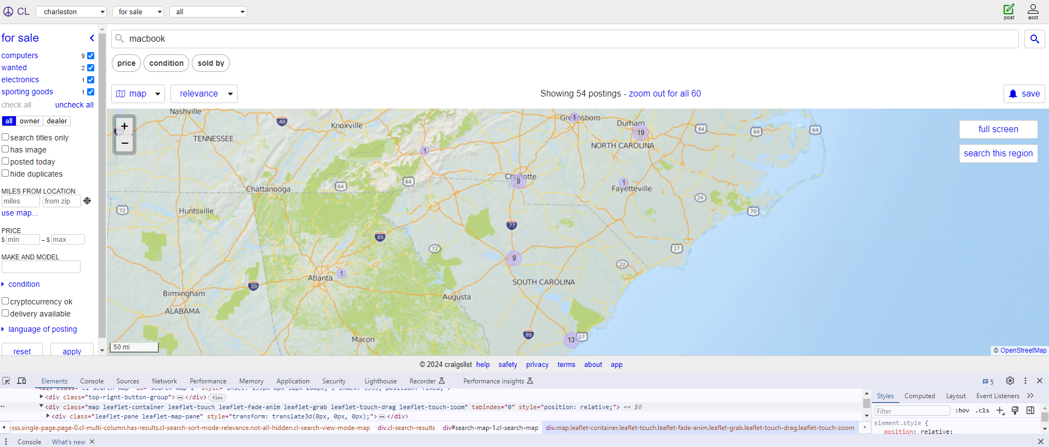
Notes:
https://charleston.craigslist.org/search/sss?query=macbook#search=1~map~0~0~36.1966~-88.1674~32.5970~-71.4882

Slide 4
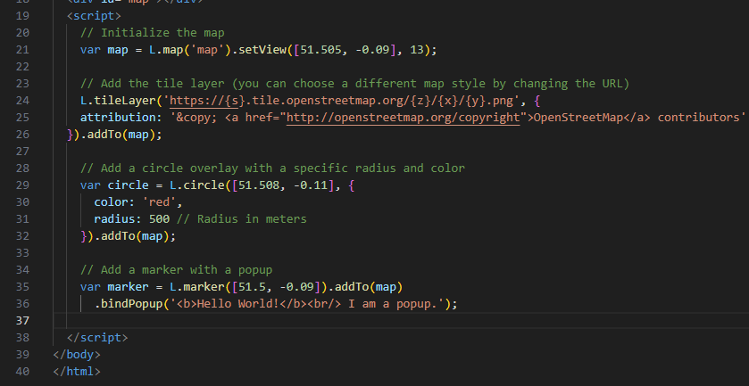
Leaflet Code Example
Features include:
Initializing map view
Adding you map of choice (can be a static image)
Properties such as circle overlay (range measures using radius)
Markers to display location
Popups display information about marker placed
Notes:
https://leafletjs.com/

Slide 5
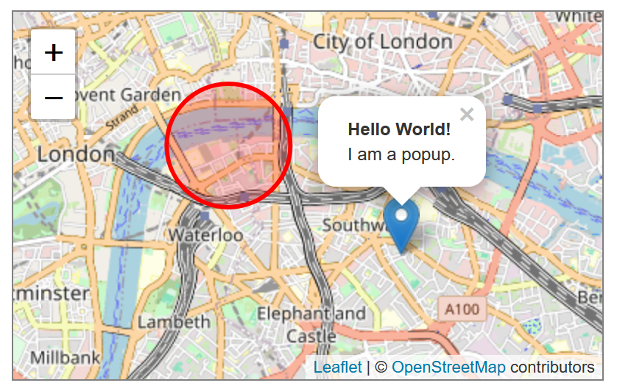
Leaflet Webpage Example
Interactive tools
Popup providing information to the user
Properties such as a circle
Marker indicating location
Notes:
GitHub Repository Like: https://github.com/Leaflet/Leaflet

Slide 6
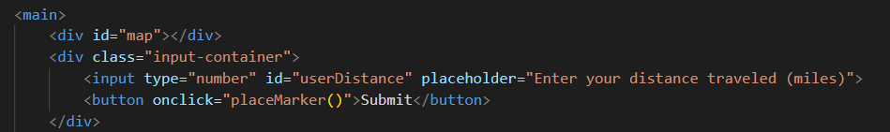
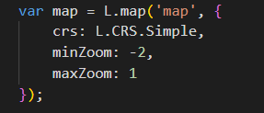
Step 1: Create Map
We create a new map by calling L.map('map'), which tells Leaflet to look for an HTML element with the ID of "map" to display the map.
The crs: L.CRS.Simple part sets the Coordinate Reference System to a simple Cartesian coordinate system, which is useful for non-geographical, flat maps — like a map of Middle-earth.
minZoom and maxZoom control how much users can zoom in and out on the map.

Slide 7
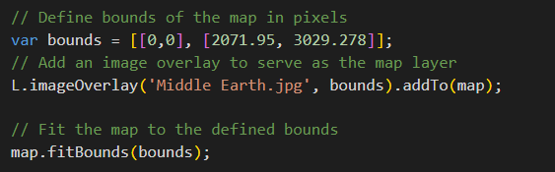
Step 2: Convert image into Leaflet
Define Bounds: This line sets the boundaries of the image in the map. [[0,0], [2071.95, 3029.278]] means the image starts at coordinates (0, 0) and stretches to (2071.95, 3029.278).
Image Overlay: L.imageOverlay('Middle Earth.jpg', bounds) creates a new image overlay, specifying the image file (Middle Earth.jpg) and applying it within the defined bounds.
Fit Map to Bounds: map.fitBounds(bounds) ensures that users will see the entire map of Middle-earth as soon as they open the webpage.

Slide 8
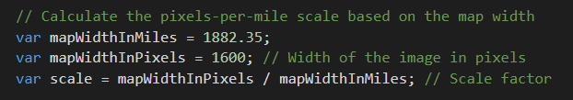
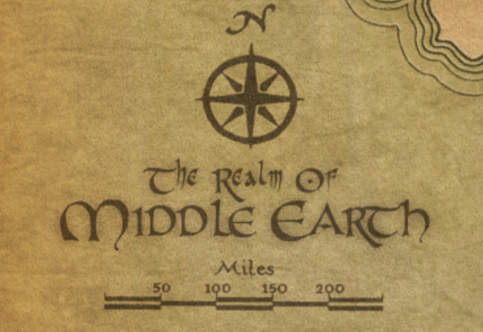
Step 3: Scale Map to Miles
Map Width in Miles: var mapWidthInMiles = 1882.35; Found calculating 2 points on the legend, and extrapolating to the whole map.
Map Width in Pixels: var mapWidthInPixels = 1600. Horizontal dimension of the map image in pixels
Scale Calculation: var scale = mapWidthInPixels / mapWidthInMiles. This calculation finds the number of pixels that represent one mile on the map
100 miles = 85 pixels
100 / 85 = 1.17 miles
1.17 * 1600 = 1882.35

Slide 9
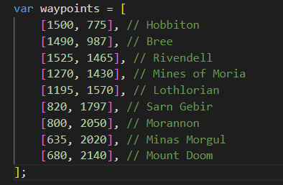
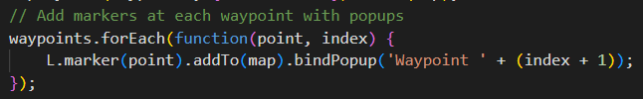
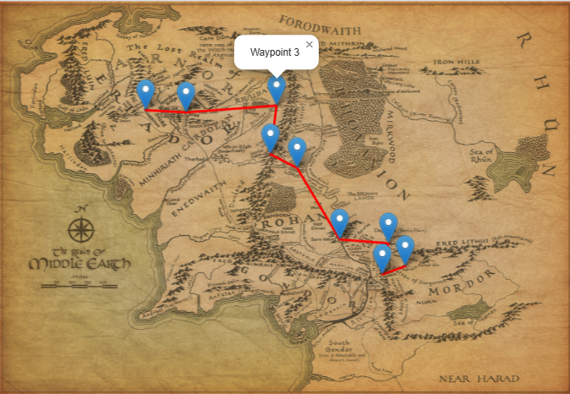
Step 4: Adding Waypoints and Routes
Create array to plot the entire route
Used Leaflet's L.marker function, which adds interactive marker objects to the map. Each marker is associated with a popup that displays its order along the route, making it informative when clicked.

Slide 10
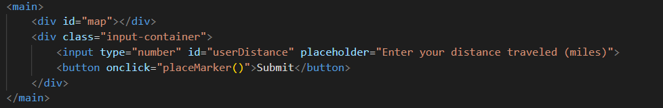
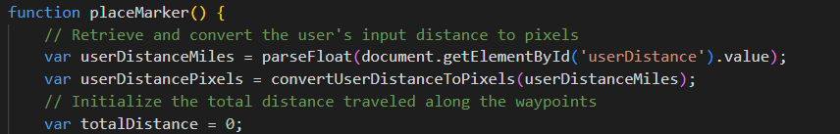
Step 5: User Input
Input Field: An HTML input element where users can enter a number (distance in miles).
Button: A button that users click to submit their distance, which triggers the placeMarker() function.
Get Input Value: The function retrieves the value from the input field, converts it from a string to a floating-point number (to handle decimal values), and stores it in userDistanceMiles.
Further Processing: The input distance is processed (converted to pixels and compared to the route's length) to determine where to place the marker on the map.

Slide 11
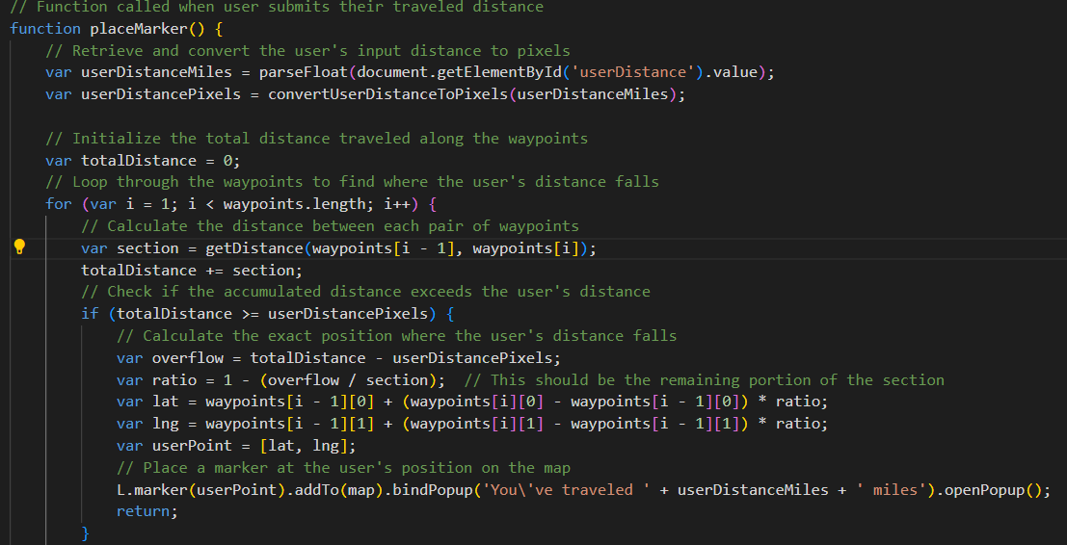
Step 6: Place Marker based on User Input
Here, the user's input in miles is converted to pixels, giving you a pixel measurement to work with on the map.
This determines how much further the accumulated distance is beyond the user's input distance. This excess will help calculate how far back along the current segment the actual stopping point is.
This code accumulates distances between waypoints. It starts from zero and adds the distance of each segment until it either meets or exceeds the distance entered by the user.
This calculates the ratio of the distance that needs to be backtracked on the current segment .
This uses linear interpolation to calculate the exact latitude and longitude of the stopping point. The interpolation formula adjusts the position based on the ratio along the segment between the previous waypoint and the current one.
This creates and adds a marker at the calculated stopping point on the map and opens a popup that tells the user how far they've traveled

Slide 12
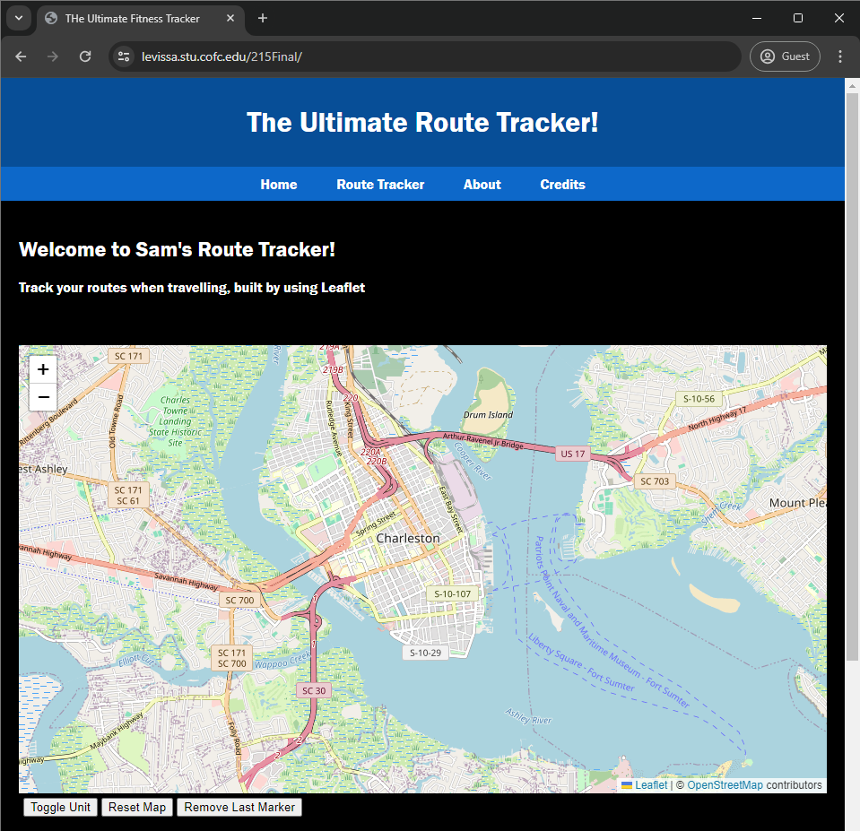
Sam’s Ultimate
Route Tracker!
Notes:
URL: https://levissa.stu.cofc.edu/215Final/

Slide 13
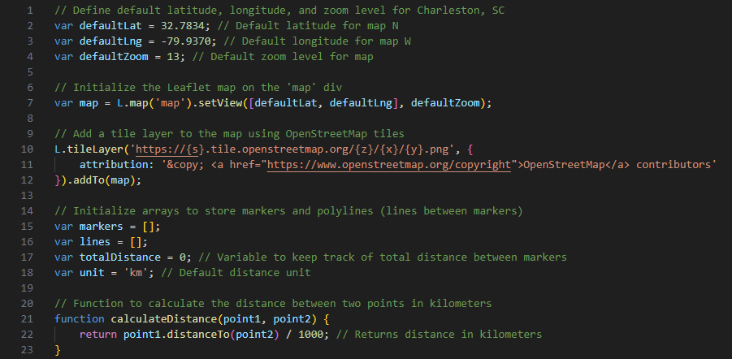
Step 1: Creating the Map & Basic Calculations
Initialize default view of map
Declare array functioning as storage for makers/user inputs
Calculates the distance between two point relative to the map
Notes:
URL: https://levissa.stu.cofc.edu/215Final/

Slide 14
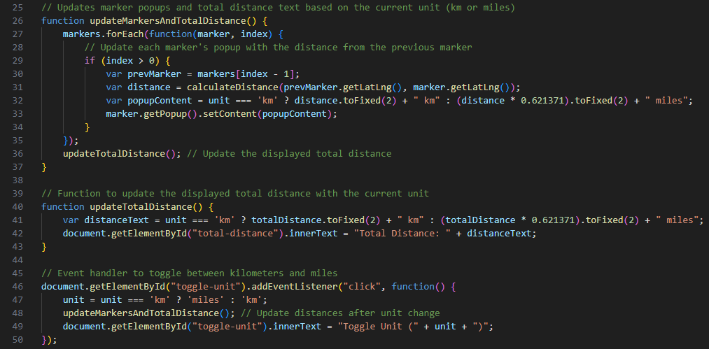
Step 2: Distance Calculations and Waypoint Handling
Updates popups and total distance text based on current unit
Continuously updates the total distance displayed
Represents the toggle switch for units, km ⬄ miles
Notes:
URL: https://levissa.stu.cofc.edu/215Final/

Slide 15
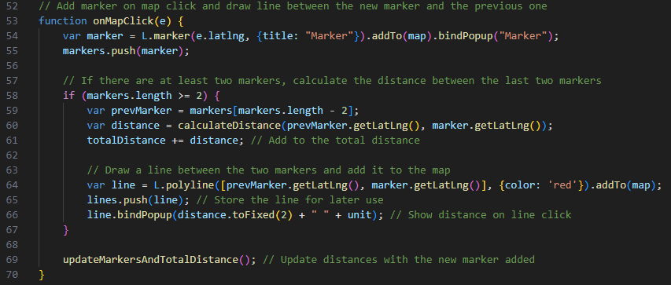
Step 3: Display Visual Elements
Represents the user input registered as a click to place marker
Sets conditions to calculate the distance between two waypoints
Red line is drawn to indicate distance/route
Notes:
URL: https://levissa.stu.cofc.edu/215Final/

Slide 16
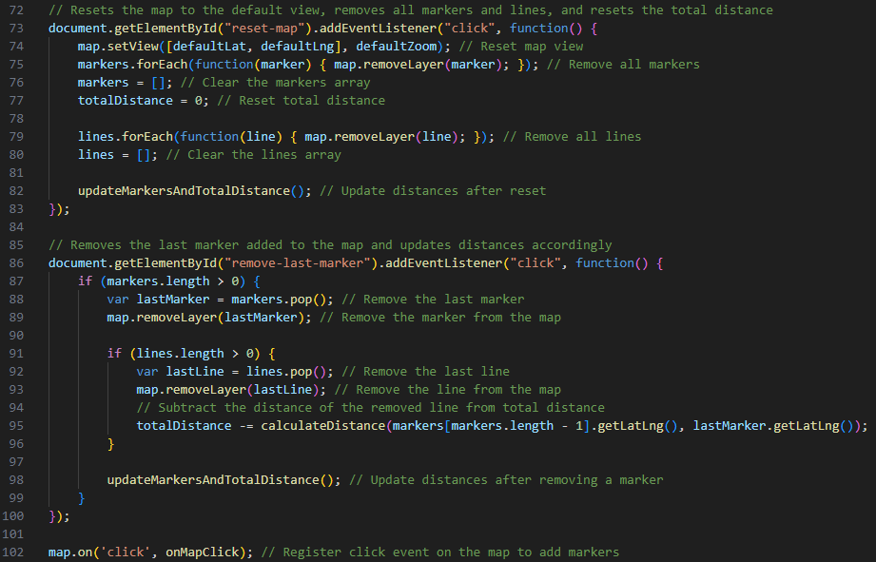
Step 4: Reset/Remove Elements
Resets map elements such as markers, popups and routes
If user wanted to remove markers but not all, they can remove the last marker placed.
A user’s input will be registered as a click which will proceed to place a waypoint
Notes:
URL: https://levissa.stu.cofc.edu/215Final/

Slide 17
Links
Middle Earth Journey Tracker
https://montielea.stu.cofc.edu/MiddleEarthJourneyTracker/
The Ultimate Route Tracker!
https://levissa.stu.cofc.edu/215Final

Slide 18
Questions
How would you add an additional waypoint to the already existing code?
How do we scale the map to miles?
Can you name at least two things you can add to a Leaflet map.
Notes:
Answers:

